Slide 1
Before you start working on this PPT:
Download a copy of this template to your computer
Click on “New Slide” on the top to choose between all types/colours of slides
Design options for your presentation:
  Always use the ITM blue/green as main colour, and
  Use the provided colour options for each of your sub-chapters (optional).
Use the guide on the last two slides to change/adjust image
Adjust your details on the ‘thank you’ slide (or delete it)
Delete these slides before you present ☺

Slide 3

Title
Presentation
Subtitle Presentation

Slide 4
Example Chapter slide
Two layouts are available: with a graphic or with an image. Of each version six color variations can be chosen.

Slide 6
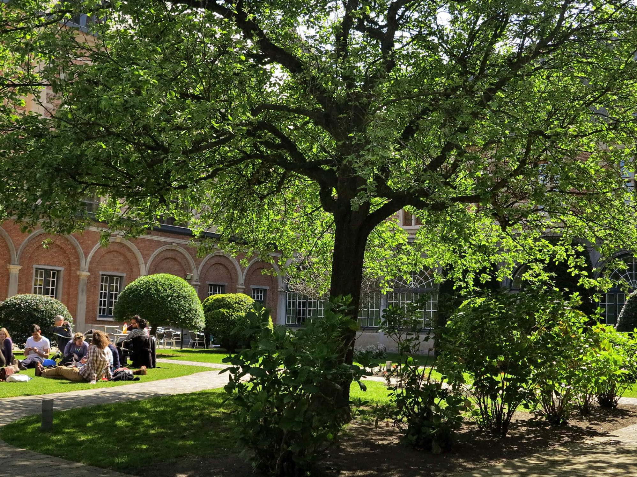
Thank you!
First Name Surname
f.surname@itg.be
www.itg.be

Slide 7
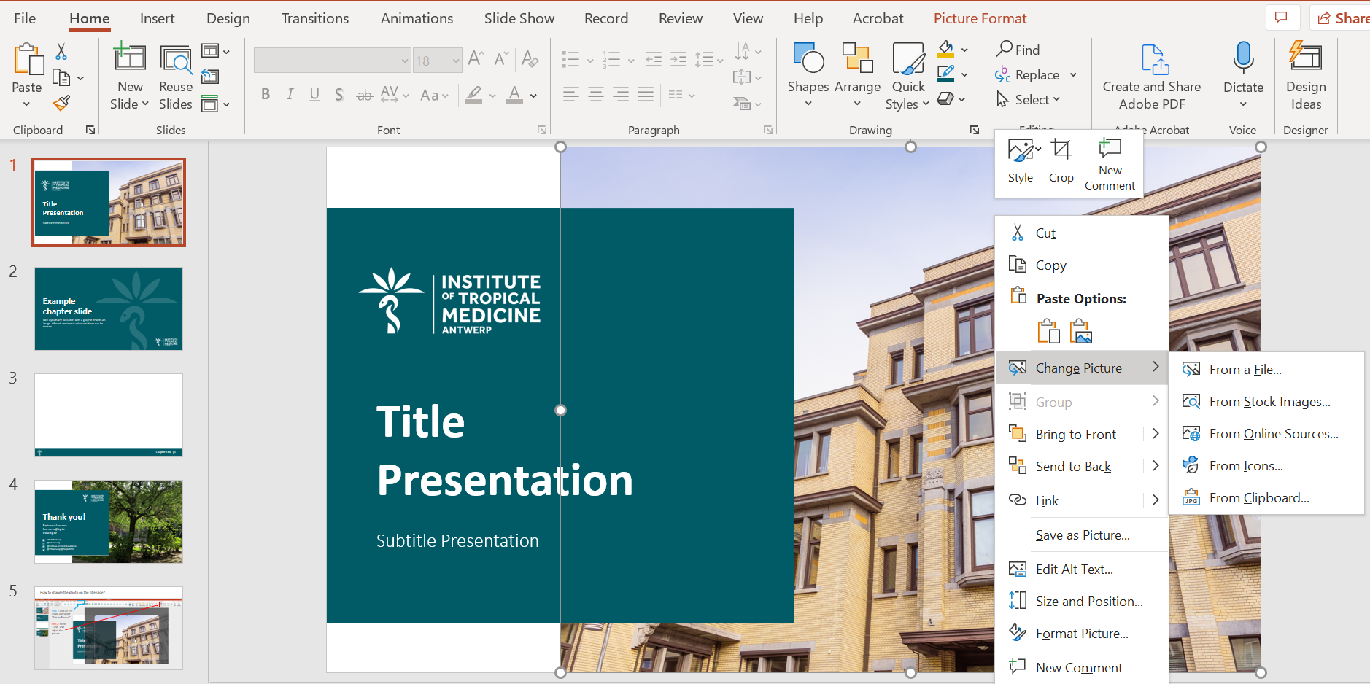
Change photo on the title/header/thank you slides?
Step 1: right click on the image and select “Change Picture”
Step 2: select “From a File” and insert a new picture

Slide 8
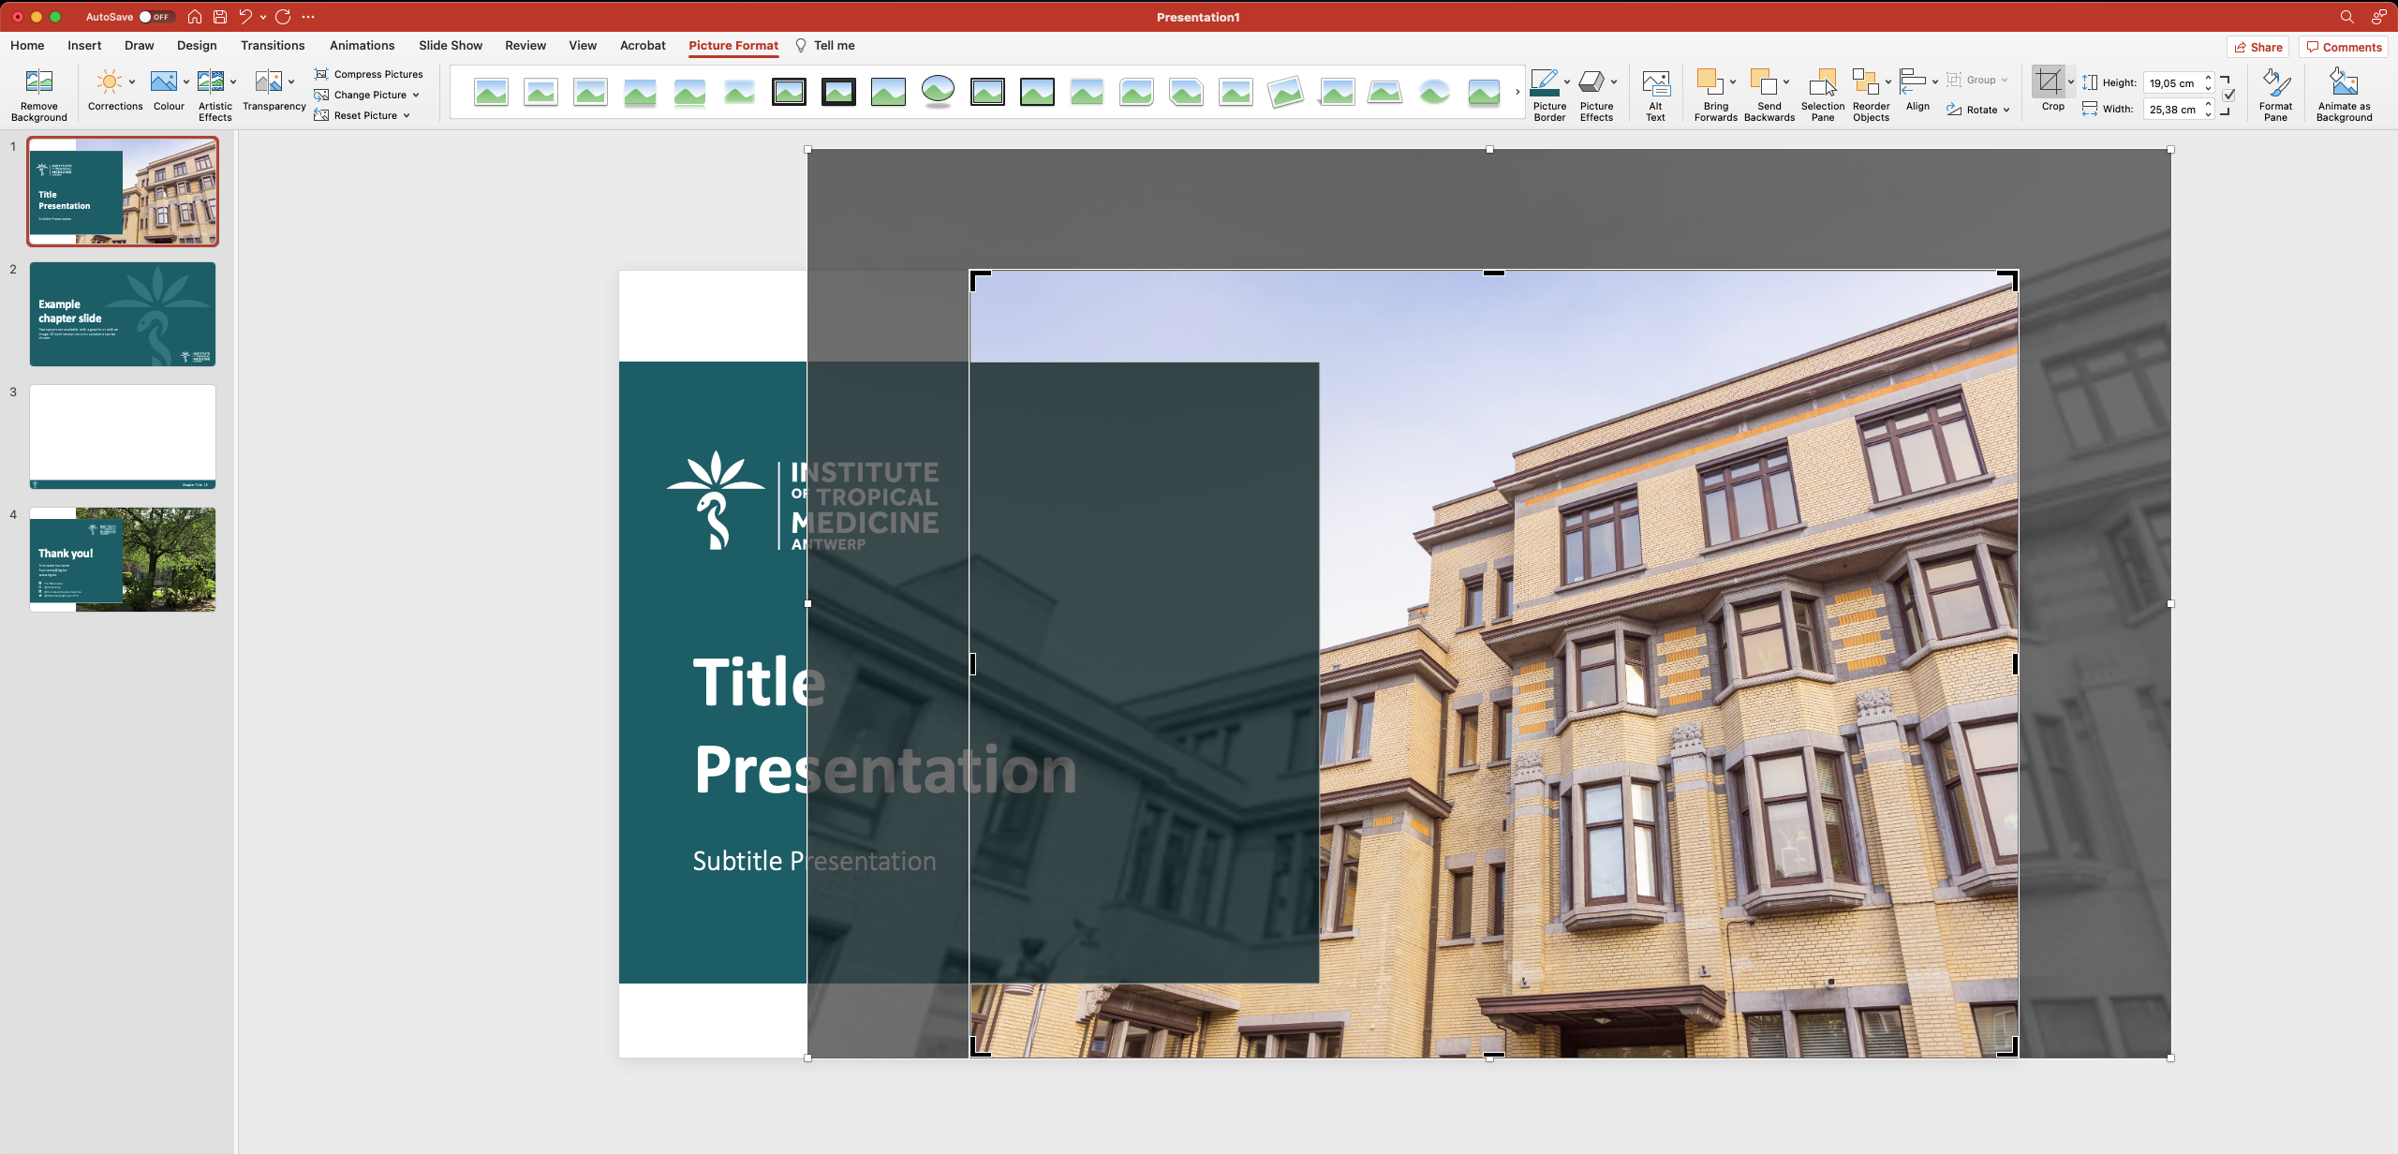
Adjust the photo?
Step 1: click on the image and select “Picture Format”
Step 2: select “Crop” and adjust the picture

